Slide 1
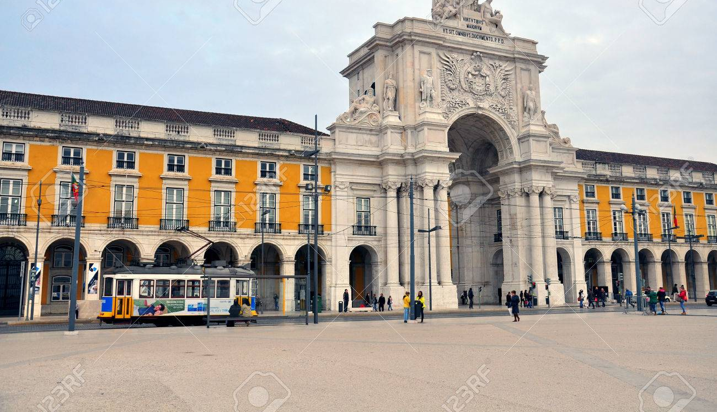
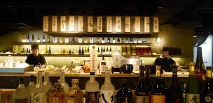
Opening a Sake bar in Lisbon
April 2019

Slide 2
Opening a Sake bar in Lisbon | Challenge
The challenge consists of finding the right location in the city of Lisbon, Portugal, for opening a Sake bar. According to many available online resources (such as: https://valueinvestasia.com/restaurants-cluster), it makes sense for restaurants to cluster, e.g., being closer to similar restaurants.
In the particular case of Sake bar, we believe that it makes sense to be close to Japanese and Sushi restaurants, which already attract Japanese or Japanese culture loving clientele. We expect that the Sake bar will benefit by providing before and after dinner drinks to the patrons going to those restaurants, and, in some cases, even provide light meals.
After the successful opening of five Sake bars in Madrid and Salamanca, Spain, our friend Hiro S. Ake contacted to help him find the right location for his first Sake bar in Portugal.

Slide 3
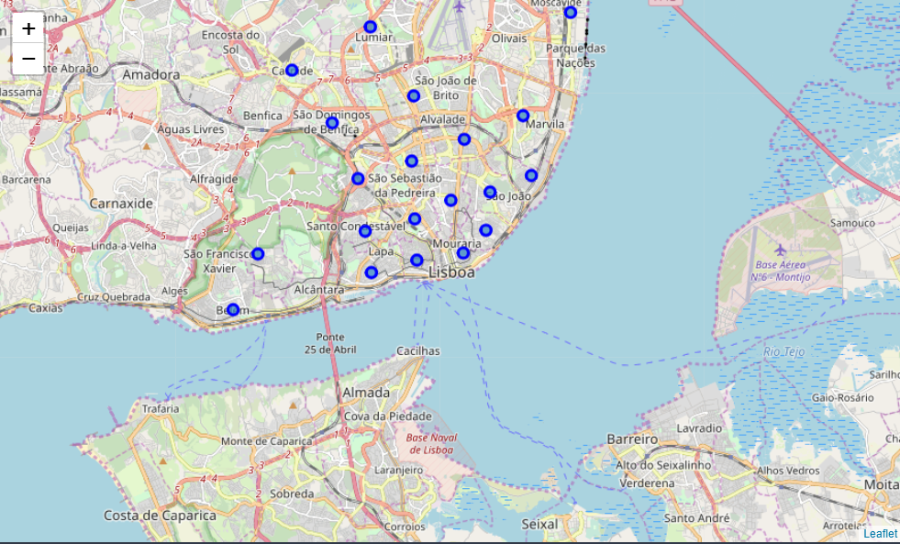
Lisbon neighborhoods

Slide 4
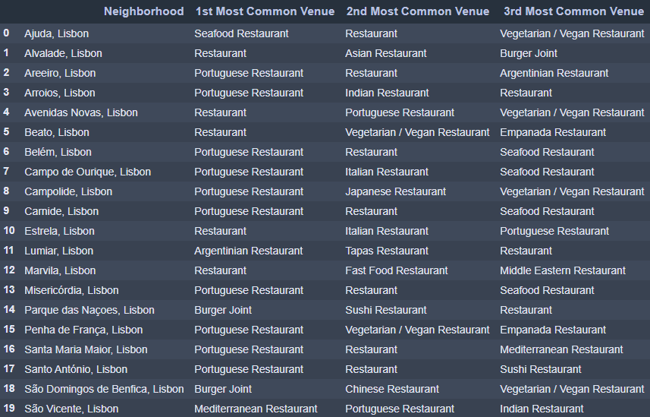
Top 3 restaurant category by neighborhoods (powered by Foursquare)

Slide 5
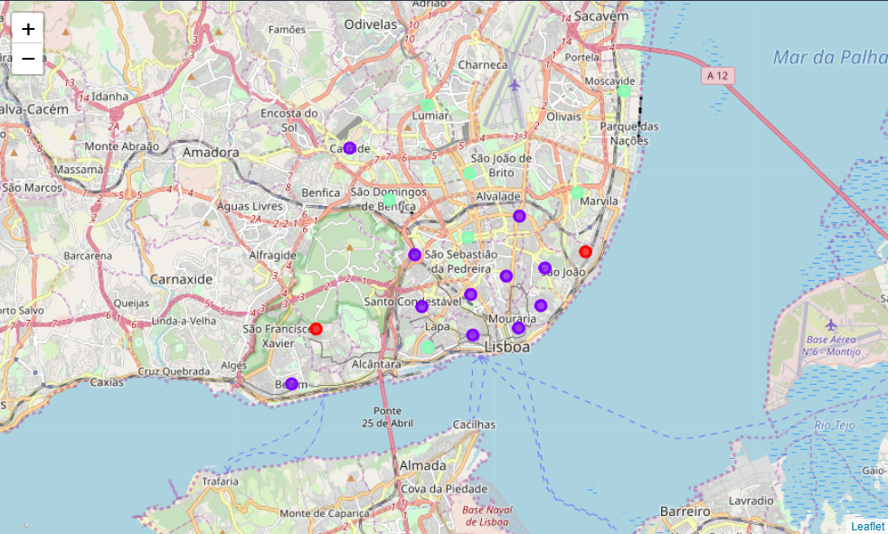
3 clusters: - Cluster 0 (red) | Mostly meatless restaurants; - Cluster 1 (purple) | Portuguese/Classic restaurants; - Cluster 2 (green) | Informal dining.

Slide 6
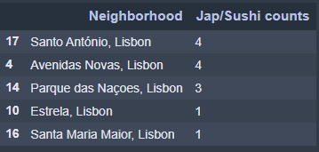
Neighborhoods with higher number of Japanese and Sushi restaurants

Slide 7
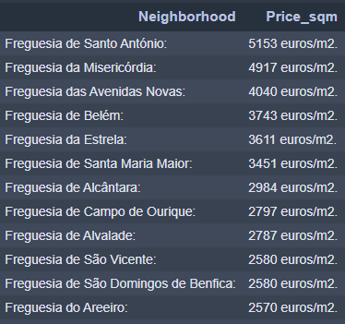
Rental price per sqm per neighborhood

Slide 8
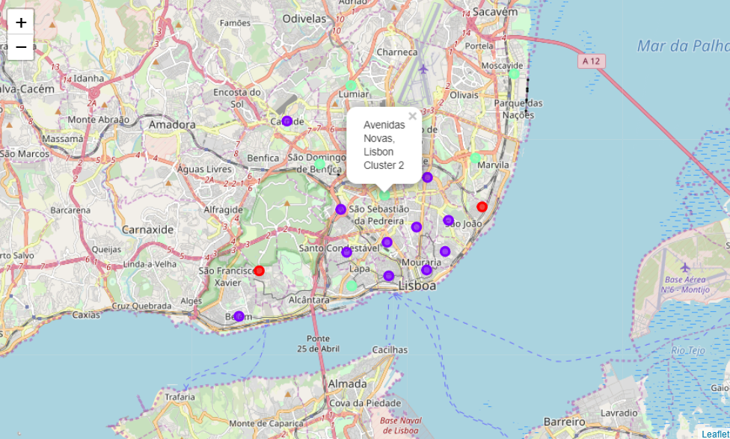
Final recommendation Avenidas Novas (informal dining + higher number of jap restaurants + not so expensive rental)

